Slide 1


Sexually Transmitted Infections and PID
Dr.Girum Gizachew
Dept.of Obstetrics and Gynecology

Slide 2
Outline
Introduction
Epidemiology
Public Health Impact of STDs
Relationship between STIs and HIV
Approach to STD Diagnosis and Treatment
The Syndromes of STD
PID
Summary
References

Slide 3
Introduction
STI(sexually transmitted infections) refers to a pathogen that causes infection through sexual contact, whereas the term STD refers to a recognizable disease state that has developed from an infection.
They are one of the most common causes of illness in the world and have far reached health, social and economic consequences .

Slide 4
Epidemiology
STIs are common in adolescents .
The prevalence is higher in urban than rural
Higher in unmarried and young adults
Developing countries are affected more – limited access
Largest population of patients reside south and south east Asia followed by Sub Saharan Africa, Latin America and the Caribbean

Slide 5
Transmission
Unprotected sexual intercourse
Mother-to-child transmission during pregnancy, childbirth and breastfeeding.
Other uncommon mode of transmissions can be
unsafe use of needles or injection, transfusion with blood and blood products and Hand to genital transmission

Slide 6
Public health impact of STD
Health consequences – increased morbidity and mortality , infertility and reproductive issues , adverse pregnancy outcomes
Economic burden – health care costs , loss of productivity
Social and psychological impact –stigma and discrimination , impact on relationships
STIs have public health importance because of their magnitude, potential complications and their interaction with HIV/AIDS.

Slide 7
Relationship between STIs and HIV
The relationship between STIs and HIV/transmission has been described as an epidemiological synergy. In addition, HIV and STIs share the same risk factors. Thus, it is very critical to strengthen STI prevention and also to prevent the spread of HIV infection.

Slide 8
STIs enhance the sexual transmission of HIV through:
A. STIs that primarily cause ulcers disrupt the integrity of the skin barrier enabling HIV easy access through such defects in the skin. The presence of genital ulcers is increases the risk of HIV transmission by 5 folds.
B. STIs that primarily cause inflammation such as gonorrhea, trichomoniasis, and chlamydial infections present a weak barrier to HIV.
C. STIs Increase viral shedding (reported in genital fluids of patients with STIs) and increase susceptibility to HIV (STI treatment has been demonstrated to significantly reduce viral shedding)

Slide 9
HIV infection affects STIs through:
A. HIV alters susceptibility of STI pathogens to antibiotics
B. Increased susceptibility to STIs among immune suppressed individuals
C. The clinical features of various types of STIs are influenced when there is co-infection with HIV.
• Syphilis has atypical presentation with a tendency to rapidly progress to neurosyphilis. Both the specific and the non-specific treponemal serologic tests for syphilis may be non-reactive in the presence of infection with T. Pallidum when there is co-infection HIV.
• Atypical lesions of chancroid are common and tend to be less purulent often with indurations mimicking primary syphilis. The lesions could as well be extensive and multiple which could be associated with fever and chills

Slide 10
Recurrent or persistent genital ulcers caused by Herpes simplex virus are common in patients with HIV and they are often multiple and extensive.
D. The treatment of conventional STIs is also affected when infection with HIV coexist. Risk of treatment failure following single injection of benzathine penicillin is increased among patient with primary syphilis.
Severe genital herpes may require treatment of primary episode or suppression of recurrence with acyclovir. However, resistance to acyclovir may be subsequently develop.

Slide 11
Approach to diagnosis and treatment
Classical approaches
Etiologic diagnosis
Clinical diagnosis
2. Syndromic approaches

Slide 12
1. Classical approaches
Etiologic -Avoids over treatment.
-Conforms to traditional training.
-Satisfies patients who feel not properly Attended
-can be used to screen asymptomatic
But
Requires skilled personnel and sophisticated lab equipment.
Not appropriate for primary health care level
Expensive, time consuming
results may not be reliable.
Delay in treatment

Slide 13
Clinical
-Saves time for patients
-Reduces lab expenses
But
Requires high clinical skill
Mixed infection often overlooked
Doesn’t identify asymptomatic STIs

Slide 14
2.Syndromic approaches
Problem oriented (responds to patient’s symptoms)
Highly sensitive and doesn’t miss mixed infections
Treats the patient at first visit
Can be implemented at primary health care level
Use of flow charts with logical steps
Provides opportunity and time for education and counseling

Slide 15
But It misses sub-clinical infection Rx with multiple drug might be expensive needs training

Slide 16
Syndromic Management
1) Genital ulcer
2) Inguinal Bubo
3) Abnormal vaginal discharge
4) Lower abdominal pain
5) Urethral discharge
6) Scrotal swelling
7) Neonatal conjunctivitis

Slide 17
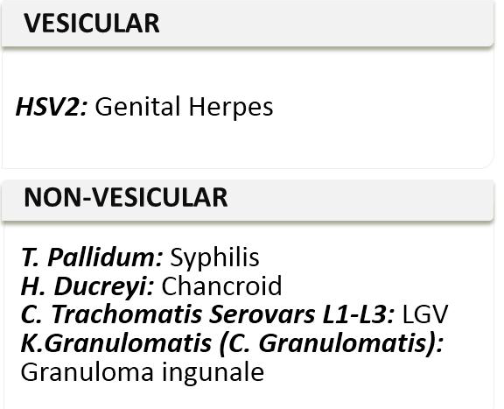
Genital ulcer

Slide 18
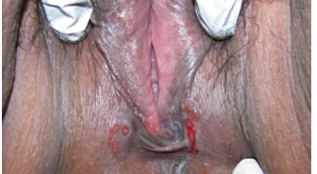
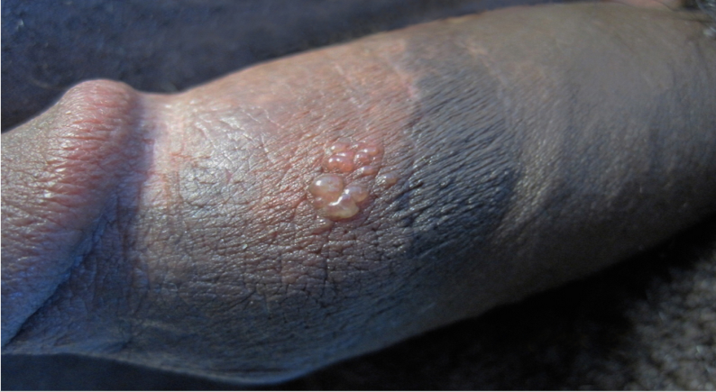
Genital Herpes (HSV)
Etiology: HSV 2 occasionally HSV 1, chronic life long infection
Lesion: primary infection – burning and itching prodrome followed by erythematous papules forming vesicles which rupture and form painful multiple ulcers and heal by crusting and without scaring

Slide 19
Clinical Manifestations
The clinical designations of genital HSV infection are
Primary infection
Non-primary First episode
Recurrent
Recurrent Infection
Less severe and shorter duration of lesions and viral shedding
Prodromal symptoms before eruption
Frequency of recurrence infection depends on the severity and duration of the initial infection, the infecting serotype and the host.
Primary infection
Incubation period is 4days
Begin as grouped vesicles with associated underlying erythema that progress to vesicopustules, erosions and shallow painful ulcer
Dysuria, fever tender local LAP

Slide 20
Diagnosis: typical clinical presentation, Gold standard is tissue culture
PCR may have more sensitivity, HSV type specific antibodies may add clarity
Treatment: analgesics – acetaminophen, codein; antivirals not be necessary – does not eradicate the virus
Episodic therapy – 1st episode, severe disease, recurrent disease – early initiation
Acyclovir 400mg/200mg po 3x/d or 5x/d for 7-10 days – 1st episode
Acyclovir 400mg/800mg 3x/d for 5 days or 2x/d or 3x/d for 5 days/2 days – recurrent episodes
Suppressive therapy – too frequent recurrences: Acyclovir 400mg po 2x/d

Slide 21
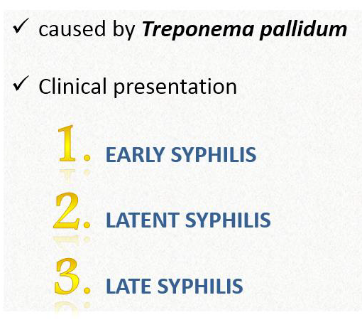
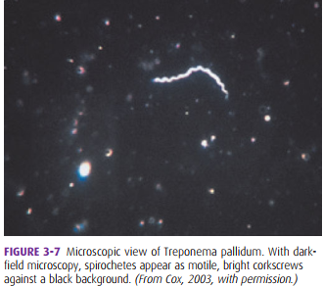
Syphilis

Slide 22
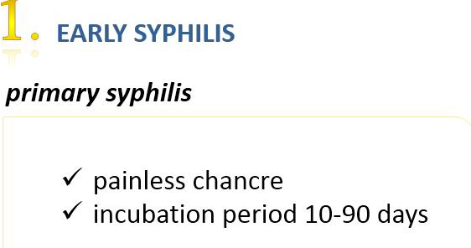
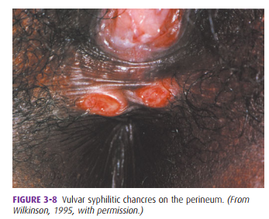
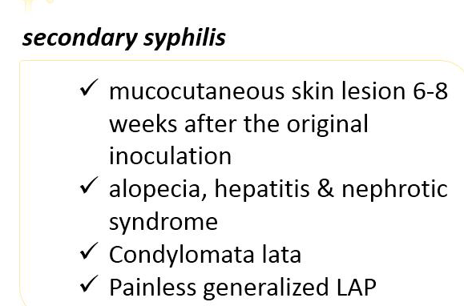
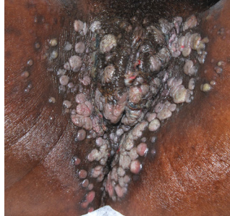

Slide 23
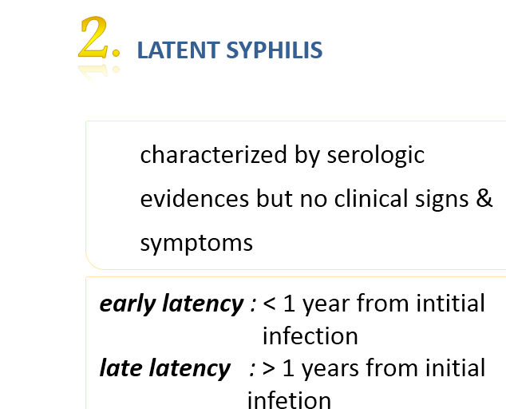

Slide 24
3. Tertiary syphilis / Late syphilis
Follows untreated earlier stages anytime within 1-30yrs after primary lesion.
Gumma is granulomatous nodular lesions in skin & bones
Neurosyphilis
Asymptomatic
Symptomatic- (meningeovascular syphilis, paresis, tabes dorsalis)
cardiovascular lesions –aortitis, aortic aneurysm,
aortic valve insufficiency

Slide 25
Diagnosis: depends on the stage of the disease
Early syphilis (primary and secondary) – dark field examination of lesion exudate
Latent syphilis –
Early latent syphilis: documented sero-conversion or sustained titer, symptoms of 1ºor 2º syphilis, partner with documented syphilis
Late latent syphilis: all others
Late syphilis (beyond secondary) – Serologic tests:
Non-treponemal tests – VDRL, RPR – screening, quantitative measurement (follow up)
Treponemal tests – FTA-ABS, TP-PA – confirmation and diagnosis
Neurosyphilis –
Serology, CSF tests (cell count, protein and VDRL), clinical/neurologic symptoms

Slide 26
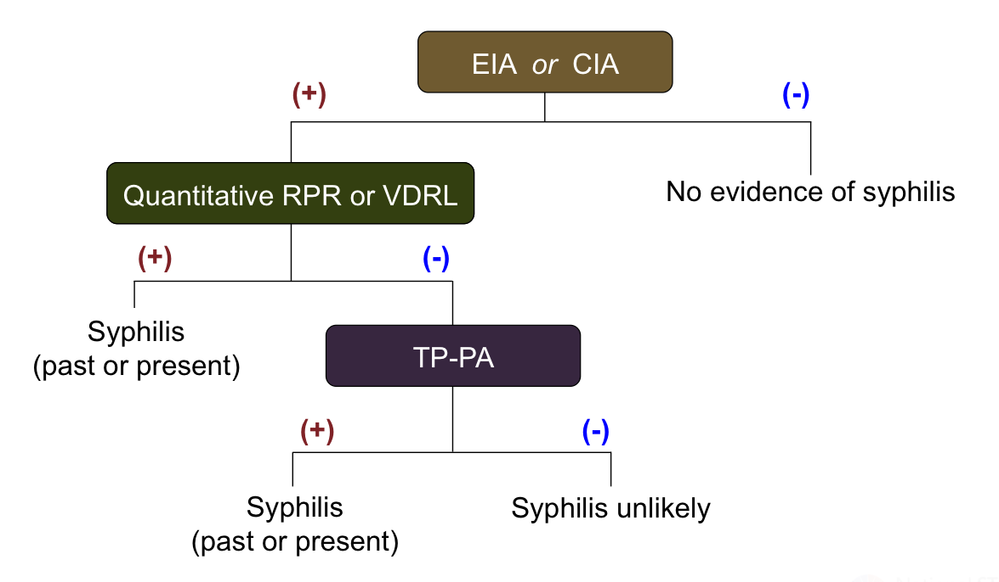
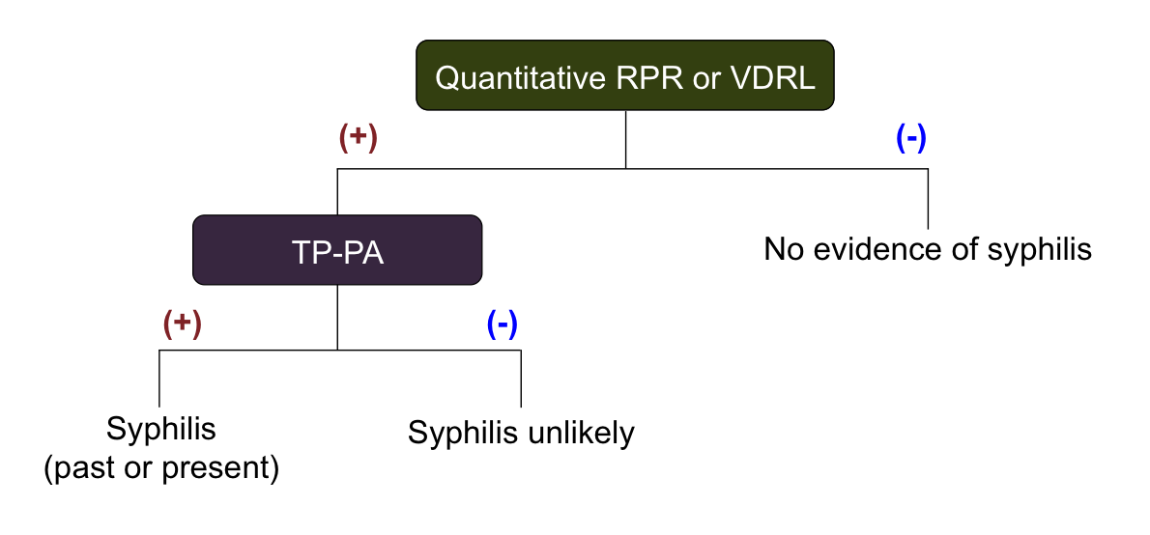
Serologic Testing Algorithms
Reverse Sequence Screening Algorithm
Traditional Screening Algorithm

Slide 27
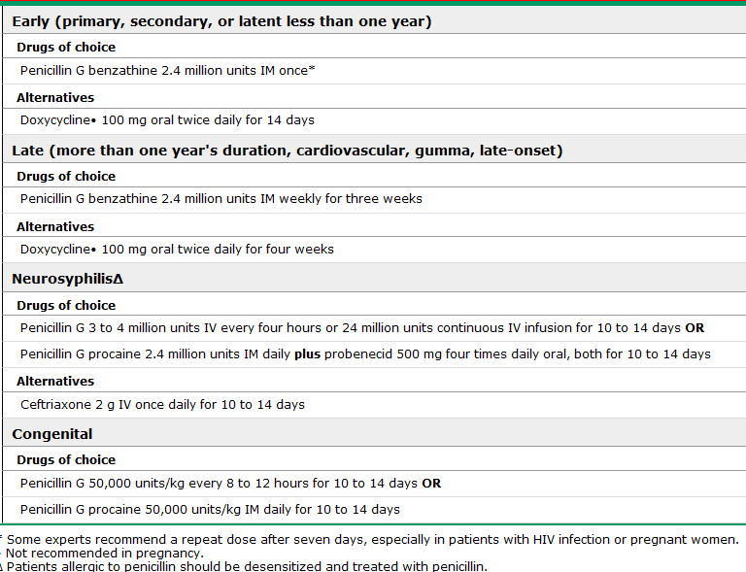
Treatment

Slide 28
Post-Treatment Follow Up
Primary and Secondary Syphilis:
Persons without HIV who are treated for primary or secondary syphilis should be reexamined clinically and serologically 6 months and 12 months following treatment.
Individuals with HIV should have post-treatment follow-up at 3, 6, 9, 12, and 24 months;
Latent Syphilis:
Persons without HIV who are treated for latent syphilis should have clinical and nontreponemal serologic follow-up at 6, 12, and 24 months.
For persons with HIV, this follow-up should occur at 6, 12, 18, and 24 months.

Slide 29
Screening for Syphilis
General population routine screening is not recommended.
screening indicated if the individual has increased risk for acquiring syphilis
Men Who Have Sex with Men
Pregnant Women
Persons with HIV
Correctional Facilities
Management of Sex Partners
For persons diagnosed with primary, secondary, or early latent syphilis,
all of their sex partners in the 90 days preceding the syphilis diagnosis.
The most recent sexual contact occur more than 90 days preceding the syphilis diagnosis, this most recent sex partner.
Persons with late latent syphilis
Who have high nontreponemal serologic test titers
Long-term sex partners of persons

Slide 30
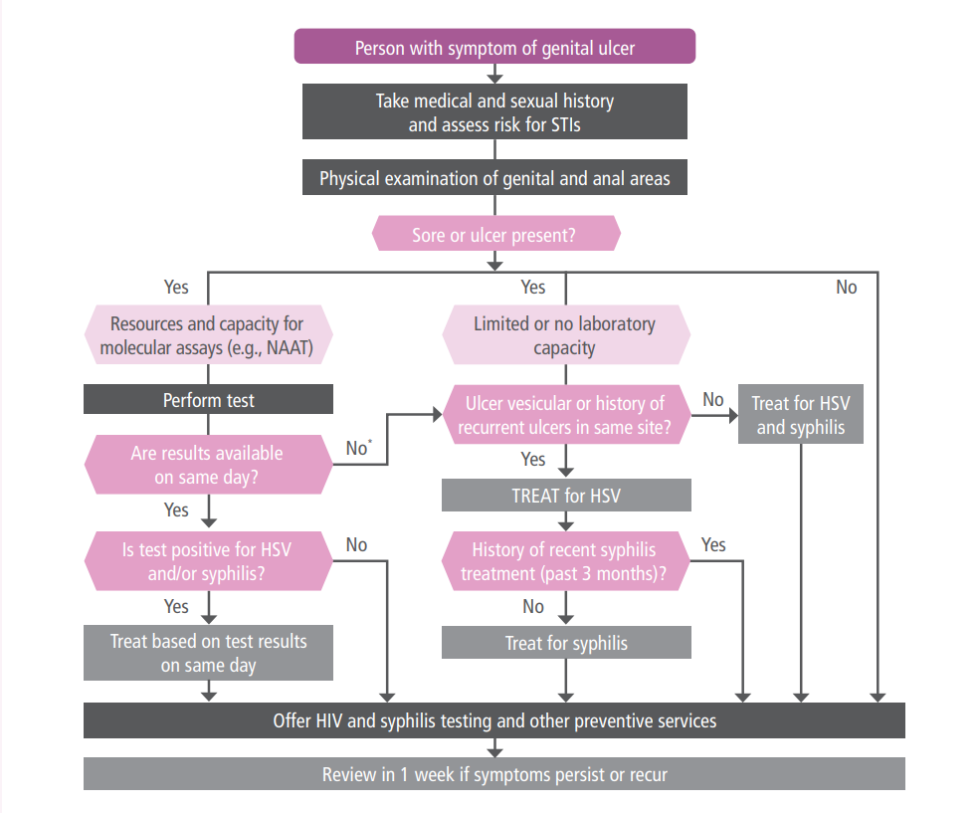
Syndrome approach for the management of genital ulcer disease

Slide 31
Granuloma Inguinale
Caused by a Gram-negative intracellular bacterium Called klebsiella granulomatis.
Transmission is almost exclusively by coitus
Incubation period 1-12 wks

Slide 32
Clinical presentation
Usually involve vulva, perineum and inguinal regions
Inguinal swelling is common with late formation of buboes
Rarely, it is manifested by chronic cervical lesion as red, ulcerative or granulation tissue & produce a chronic inflammatory exudates characterized by: lymphocytes, giant cells, and histiocytes.

Slide 33
Diagnosis:
Typical clinical presentation, no PCR test
Definitive diagnosis: Tissue biopsy – Donovan bodies
Treatment:
Azithromycine 1g weekly for 3 weeks completely healed wounds
Alternatives: Doxycycline 100mg BID, Ciprofloxacine 750mg po BID, Erythromycine base 500 mg po QID 3 weeks

Slide 34
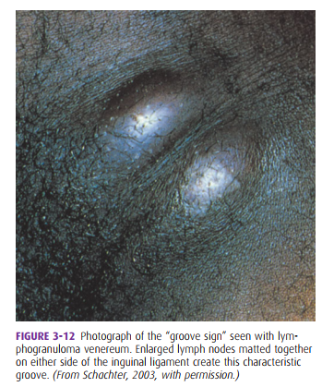
Lymphogranuloma Venereum (LGV)
Etiology: C. trachomatis serovars L1, L2, or L3
Lesion: tender inguinal and/or femoral lymphadenopathy with self limited genital ulcer;
Nodes may rupture which leads to chronic sinuses
recto-proctocolitis – lymphangitis may manifest

Slide 35
Diagnosis:
Clinical suspicion, epidemiologic information, and the exclusion of other etiologies
Culture, direct ImmunoFlorescens, and NAAT can be done
Chlamydia serology
Treatment:
Doxycycline 100mg po BID for 21 days
Alternatives: Erythromycin base 500 mg po QID 21 days

Slide 36

Vaginal discharge

Slide 37
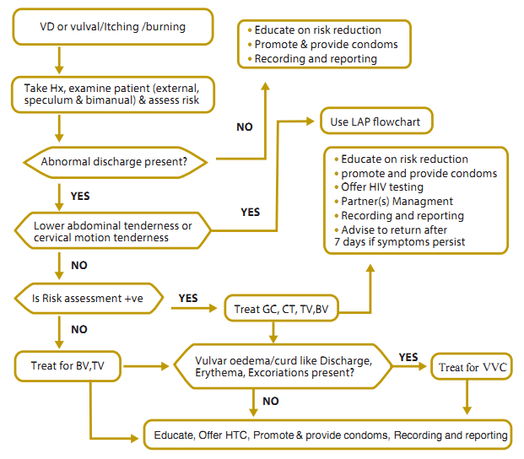
: THE ALGORITHM OF SYNDROMIC CASE MANAGEMENT OF VAGINAL DISCHARGE SYNDROME

Slide 38
Bacterial vaginosis
The most common cause of vaginal discharge in women of childbearing age, accounting for 40 to 50 percent of cases
A complex change in the vaginal flora, not considered a sexually transmitted disease although it can be acquired by sexual intercourse.
The major bacteria detected are Gardnerella vaginalis, Prevotella species, Porphyromonas species, Bacteroides species, Peptostreptococcus species,

Slide 39
Clinical features
Most cases (50-75%) asymptomatic or mild
Musty or fishy odor of vaginal discharge
Thin, gray-white, non-clumping, homogenous ,"fishy smelling“ vaginal discharge
If speculum examination is feasible, the homogeneous discharge may be observed to be adherent to the vaginal wall, and the cervix is usually normal in appearance.

Slide 40
Diagnosis: Amsel’s Criteria – 3/4
Homogeneous, thin,greyish, white discharge coates the vagina
Clue cells on wet mount
PH > 4.5
Whiff test positive – fishy odor on KOH 10%

Slide 41
Treatment
Resolves spontaneously in up to one-third of non pregnant and one-half of pregnant women
Metronidazole is the most successful therapy(>90%cure rate)
500 mg twice daily for seven days OR 0.75 % Metronidazole vaginal gel 5 g once daily for 5 days

Slide 42
TRICHOMONAS VAGINALIS
Most common non-viral and non chlamydial
sexually transmitted disease.
The classically described green, frothy , foul-smelling discharge is found in fewer than 10 percent of symptomatic women.

Slide 43
Clinical presentation
– symptoms Among symptomatic women, presents with an abnormal vaginal discharge as perceived by the woman. About 50% of symptomatic women report vulval itching. The discharge may be described as yellow and may appear purulent.
On speculum examination, a discharge of variable color can be seen in the vagina – classically described as yellow or greenish and may be frothy

Slide 44
Diagnosis:
NAAT
Wet mount microscopy
Culture
Treatment:
Reduces symptoms and transmission
Metronidazole 2 g po stat OR Tinidazole 2 g po stat
Alternative: Metronidazole 500 mg po BID for 7 days
Partner treatment is critical for cure and relief

Slide 45
Vulvovaginal Candidiasis (VVC)
Caused by C Albicans and other species
Symptoms: pruritis, soarness, dyspareunia, external dysuria, discharge (thick curdy)
The discharge is not always curd-like (sometimes described as cottage-cheese-like in character) but can vary from watery to homogeneously thick.
On examination, the vulva may be erythematous and excoriated. The vulva and the labia may be swollen.

Slide 46
Continued ……………….
Diagnosis –
- Microscopy ( wet mount or KOH )
Findings – budding yeast cell , hyphae
or pseudohyphae
- Vaginal pH – normal
- Culture – gold standard

Slide 47
TREATMENT
Miconazole vaginal pessaries, 200 mg inserted at night for 3 nights
OR
Clotrimazole vaginal tablet, 100 mg, inserted at night for 7 nights
Alternative -Fluconazole 150 mg (or 200mg), orally, single dose OR Nystatin, 200,000-unit vaginal tablet, inserted at night for 7 nights

Slide 48
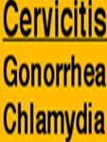

Slide 49
Chlamydia trachomatis
Chlamydia trachomatis is the most common bacterial agent of sexually transmitted genital infections.
Chlamydiae are obligate intracellular microorganisms that have a cell wall similar to that of gram-negative bacteria.

Slide 50
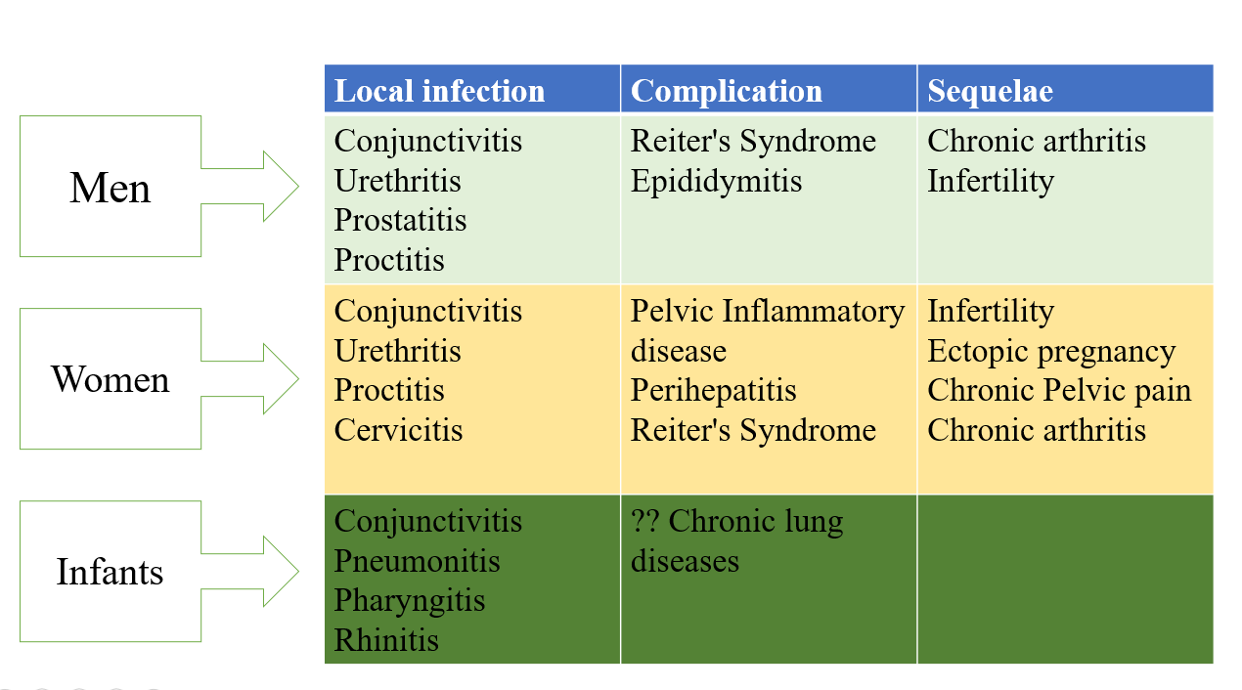
Clinical syndromes caused by C. trachomatis

Slide 51
Risk factors for infection
Adolescents and young adults
Multiple sex partners a recent new sex partner
Inconsistent use of barrier contraceptive
Unmarried status
History of prior sexually transmitted disease
Lower socioeconomic class

Slide 52
Sign and symptom in women
No symptoms(50%)
Vaginal discharge
Abnormal vaginal bleeding (postcoital)
Dyspareunia
Slow onset & progression of L. abd. Pain
Ascending infections (PID)
Fever (PID)

Slide 53
Diagnosis
Nucleic Acid Amplification Tests (NAATs)
Gold standard: NAATs are the most sensitive and specific tests for diagnosing Chlamydia trachomatis.
Cell culture –it has greatest specificity but cost can be prohibitive, and a 3- to 7-day delay in diagnosis is required

Slide 54
Continued ………
Treatment:
Doxycycline 100 mg po BID for 7 days OR
Azithromycin 1 g orally stat
Alternatives: Erythromycin base 500 mg po QID for 7 days OR Ofloxacin 200–400 mg, orally, twice daily for 7 days
Partners in the past 60 days should be treated

Slide 55
NESSERIA GONORRHEA
Is a Gram-negative, kidney-bean-shaped diplococcus.
Second most common cause of cervicitis
Asymptomatic infection is common but symptoms appear sooner than chlamydia

Slide 56
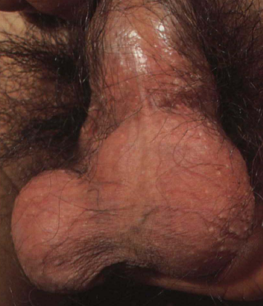
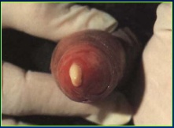
CLINICAL MANIFESTATION
In Male
Urethritis –
urethral discharge, dysuria
Complications : epididymitis, prostatitis, periurethral abscess

Slide 57
Continued ……………
In female
Cervicitis, urethritis,
Vaginal discharge, dysuria
Complications(10-20% of cases) :Salpingitis, pelvic peritonitis, tuboovarian abscess
Disseminated gonoccocal infection(DGI)

Slide 58
LABORATORY DIAGNOSIS
Specimen: Urethral swab, cervical swab, throat swab
Nucleic Acid Detection Tests
are the most sensitive test infections.
Culture: on enriched media like chocolate agar or
Thayer-martin agar
At present, culture is primarily used for antimicrobial resistance surveillance

Slide 59
Gram stain -A quick, preliminary test that provides immediate results. This method is highly effective for detecting gonococcal urethritis in symptomatic men but has lower sensitivity in women and for extragenital infections

Slide 60
Treatment
Ceftriaxone 250 mg IM stat PLUS Azithromycin 1g po stat
Partners in the past 60 days should be treated

Slide 61
Pelvic inflammatory disease
( PID )

Slide 62
PELVIC INFLAMMATORY DISEASE
Pelvic inflammatory disease (PID) refers to acute and subclinical infection of the upper genital tract in females, involving any or all of the uterus, fallopian tubes, and ovaries.
This is often accompanied by involvement of the neighboring pelvic organs.
Results in:
-endometritis
-salpingitis
-oophoritis
-peritonitis
-perihepatitis and/or tubo-ovarian abscess.

Slide 63
Etiology
over 85 % are caused by sexually transmitted pathogens or bacterial vaginosis-associated pathogens.
Fewer than 15 % of acute PID cases are associated with
- enteric pathogens (eg, Escherichia coli, Bacteroides fragilis, Group B streptococci, and Campylobacter spp) or
-respiratory pathogens (eg, Haemophilus influenzae, Streptococcus pneumoniae, Group A streptococci, and Staphylococcus aureus) that have colonized the lower genital tract.
Others
-Post-operative pelvic peritonitis and abscess
-pregnancy-related pelvic infection
-injury or trauma-related pelvic infection
-pelvic infection secondary to spread of another infection (eg, appendicitis, diverticulitis, tumor) can also produce a very similar clinical picture.

Slide 64
presentation
Acute symptomatic PID: characterized by the acute onset of lower abdominal or pelvic pain, pelvic organ tenderness, and evidence of inflammation of the genital tract. The findings can be subtle and nonspecific.
Subacute PID:
-does not prompt a woman to present to medical care but is severe enough to produce significant sequelae appears to be relatively common.
-present with tubal factor infertility that appears likely to have been a result of past episodes of PID often give no history of PID.
Chronic PID: indolent presentation with low-grade fever, weight loss, and abdominal pain has been reported following pelvic infection due to actinomycosis and tuberculosis.

Slide 65
laboratory tests — The following tests should be performed for all females suspected of having PID:
●Pregnancy test
●Microscopy of vaginal discharge (where available)
●Nucleic acid amplification tests (NAATs) for C. trachomatis and Neisseria gonorrhoeae
●NAAT for Mycoplasma genitalium (where available)
●HIV screening
●Serologic testing for syphilis

Slide 66
Diagnosis
Acute PID: a clinical diagnosis – one major and one minor
Major criteria: abdominal tenderness, adnexal tenderness or CMT
Minor criteria: fever >38.3ºC (oral), mucopurulent discharge, leukorrhea, elevated ESR/C-RP, cervical C trachomitis or N Gonorrhea infection
Testing: done to exclude othe sources of pain
hCG, CBC, UA, cervical swab, sonography
Gold standard diagnostic: laparoscopy
Other specific diagnostics: Endometrial biopsy, imaging (TVS and MRI)
Chronic PID: history of acute PID followed by chronic pain

Slide 67
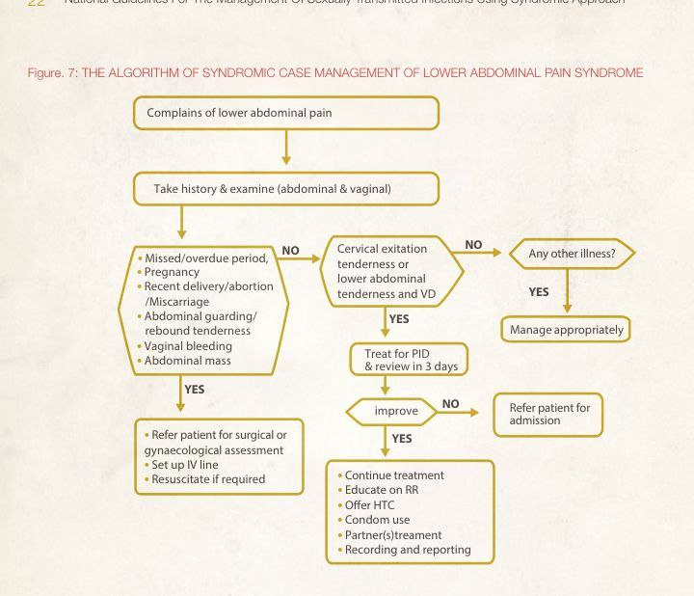

Slide 68
Indication for inpatient treatment
• The diagnosis is uncertain
• Surgical emergencies, such as appendicitis and ectopic pregnancy cannot be ruled out;
• A pelvic abscess is suspected;
• Severe illness precludes management on an outpatient basis;
• The person is pregnant;
• The person is unable to follow or tolerate an outpatient regimen; or
• The person has failed to respond to outpatient therapy

Slide 69
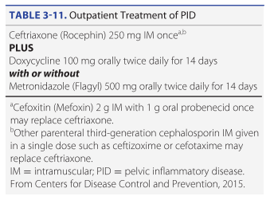

Slide 70
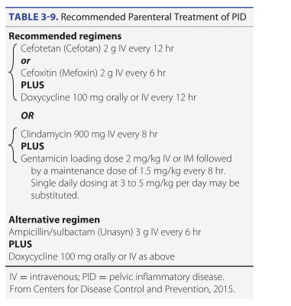

Slide 71
Summary
STIs – infections transmitted through sexual contact
Symptoms – genital ulcer, urethral /vaginal discharge , pain during urination
Complications – infertility , chronic pelvic pain ,neonatal transmission , increased HIV risk
Prevention and control of STDs are based on:
accurate risk assessment and education
pre-exposure vaccination;
Screening asymptomatic persons;
effective diagnosis, treatment of infected persons;

Slide 72
References
Williams gynecology, 4th edition
National guidelines for the management of sexually transmitted infections using syndromic approach, 2015
Center for disease control and prevention, STI guidelines 2021
WHO; guidelines for management of STI; 2021

Slide 73
Thank you

